Slide 1
Project
Amazon Sales
Data Analysis
by – Harshita Gupta

Slide 2
Objective
Development of a predictive model for predicting sales.
Perform ETL (Extract-Transform-Load) on dataset.
Develop dashboard by using tableau.
Better understand and optimise revenue generation in future
Maximize forecasting accuracy
Make current sales experience our top priority
Beneﬁts

Slide 3
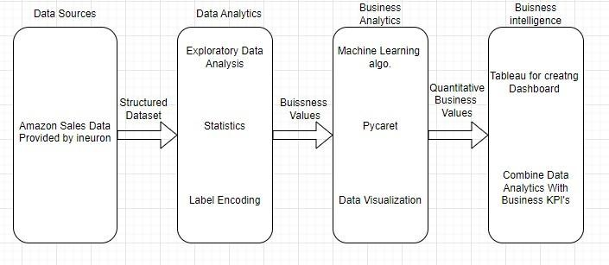
Architecture

Slide 4
Data Preprocessing:
Importing necessary libraries for data analysis such as : Pandas, Numpy, Matplotlib & Seaborn etc.
Using pd.read_csv() function stores the data in pandas dataframe named data.
Using data.shape showing number of rows and columns present in dataframe.
info() function show basic information of dataframe like null value count of each column and their data type.
Changing the data type of different column for model training and analysis.
Using describe function on dataframe for getting basic stats of numerical dataset.
Adding extra column to dataframe which contain only month, year and month with year.
Using isnull().sum() checking out total null value in all the column of dataframe.

Slide 5
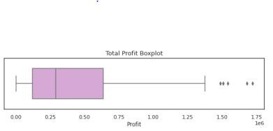
Exploratory data Analysis
Checking Outliers in the dataframe by using Box Plot
Box Plot for Total Proﬁt : Here we detect outliers in the speciﬁed column using the Z-score method and found 7 outliers.

Slide 6
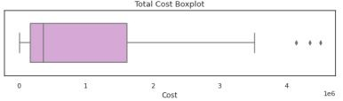
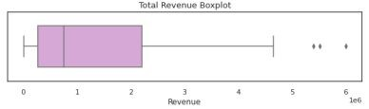
Box Plot of Total Cost : found 5 outliers in Total Cost column
Box Plot of Total Revenue : Found 6 outliers in Total Revenue column

Slide 7
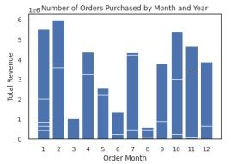
Creating a bar chart for Total Revenue and Order Month : where it showcases the number of order purchased in particular month.
Calculating the total revenue for each group with respect to Item Type and then sorting then in descending order.
Calculating the total proﬁt for each group with respect to Item Type and then sorting them in descending order.

Slide 8

Calculating correlation of 'Total Revenue', 'Total Cost' and 'Total Proﬁt' columns present in dataframe.

Slide 9
Thank You

